Slide 1
ACTIVE AND PASSIVE VOICE

Slide 2
WHAT IS VOICE ?
In traditional grammar, voice is the quality of a verb that indicates whether its subject acts (active voice) or is acted upon (passive voice).
The distinction between active and passive voice applies only to transitive verbs.

Slide 3
TYPES OF VOICE
If the subject is the person performing the action, we use the active voice. When we're not bothered about who or what carried out the action of the verb, we use the passive voice.
In other words, the subject of the sentence refers to someone or something that does not perform the action but is affected by the action of the verb.

Slide 4
POLL QUESTION
Jane decided to cancel the party
A. active
B. passive

Slide 5
Jane decided to cancel the party
A. active
B. passive

Slide 6
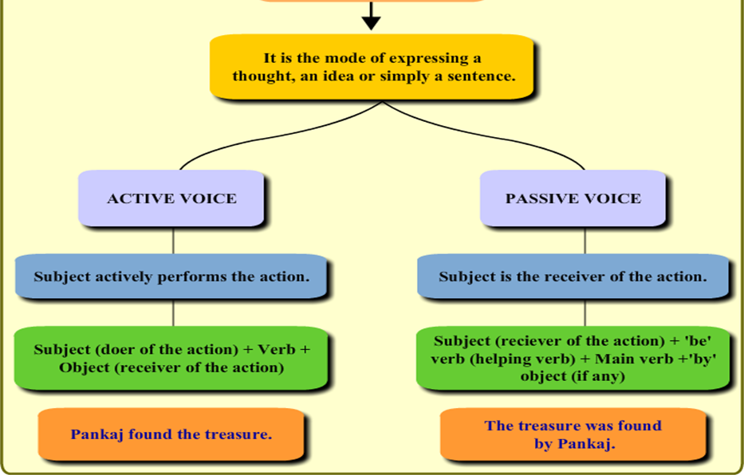

Slide 7
POLL QUESTION
The passive of an active tense is formed by inserting the verb ‘to be’ into the same tense as the active verb and adding the past participle of the active verb.
a) True
b) False

Slide 8
The passive of an active tense is formed by inserting the verb ‘to be’ into the same tense as the active verb and adding the past participle of the active verb.
a) True
b) False

Slide 9
REASONS TO USE ACTIVE VOICE
Most people prefer to use active voice because it is more direct. For instance –
Active- The waiter dropped the tray of food.
Passive – The tray of food was dropped by the waiter.
The active voice is less awkward and clearly states relationship between subject and action.
For instance – Active- Your request for funding has been denied by the review committee.
Passive – The review committee denied your request for funding.

Slide 10
REASONS TO USE PASSIVE VOICE
The active voice sentence pattern propels the reader forward through your writing thus avoiding weak prose.
In general, the passive voice is less direct, less forceful, and less concise than active voice.
Use the passive voice when you do not know or do not want to reveal the performer of an action.
Use passive voice when you want to emphasize the receiver of an action.

Slide 11
POLL QUESTION
The lecturer was impressed by your essay
A. Active
B. passive

Slide 12
The lecturer was impressed by your essay
A. Active
B. passive

Slide 13
ACTIVE VOICE
The active voice is the "normal" voice of an English sentence. Intransitive verbs (verbs with no direct object) are always in the active voice. Transitive verbs are usually in the active voice.
Subject | Verb
Johnny | laughed
Antony | got up | late
People | Eat | Pizza

Slide 14
In the active voice, the subject is the person or thing responsible for the action of the verb.

Slide 15
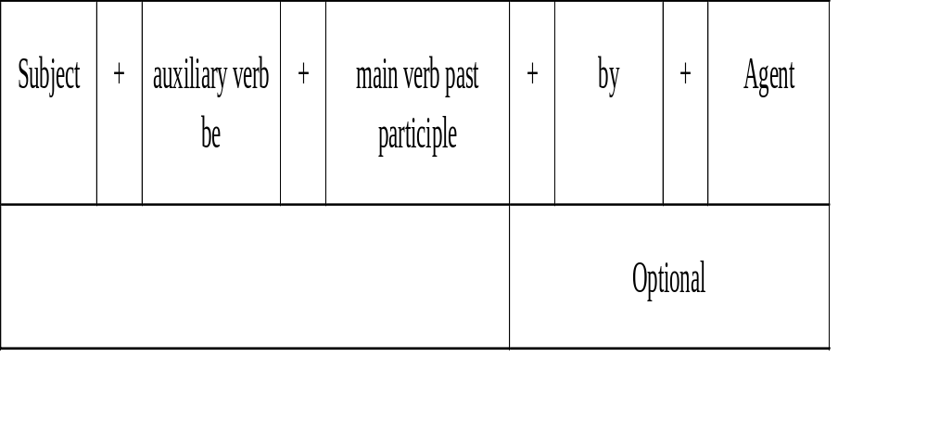
PASSIVE VOICE:
The basic structure of a passive clause is very simple:

Slide 16
The auxiliary be is conjugated in all tenses.
➢ The main verb is always the past participle.
➢ The agent is the original "doer" of the action.
auxiliary be can be conjugated for all persons and tenses
➢ main verb is invariable: past participle
➢ if there is an agent (Apple, Head Office), it is introduced by by

Slide 17
AGENTLESS PASSIVE :
The subject of an active sentence "does" the action. In a passive sentence, we express the doer (or agent) through a by phrase (the long passive) or, very often, we remove it completely (the short passive). In the following example, the agent is "the Allies":
Active - The Allies firebombed Dresden.
Passive –long- Dresden was firebombed by the Allies.
-short- Dresden was firebombed.
The short passive is also known as the "agentless passive".

Slide 18
IMPERSONAL PASSIVE:
Compare these two sentences
Last year, the Green-India scheme was announced by the Government.
Rare plants are found in Silent Valley

Slide 19
In the first sentence, the doer/agent is explicitly mentioned because the doer is important in that sentence. But in the second sentence it is not so, because either the agent or doer of the action is too obvious or unknown.
The passive construction is quite common in scientific / technical / business writing. In these types of objective writing the emphasis is usually on the action or process or thing that is described. So the ‘by phrase” is generally omitted in these writings. It is called Impersonal Passive

Slide 20
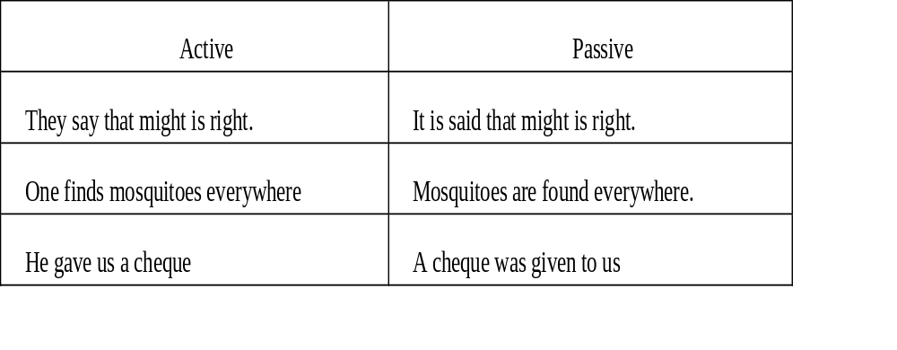

Slide 21
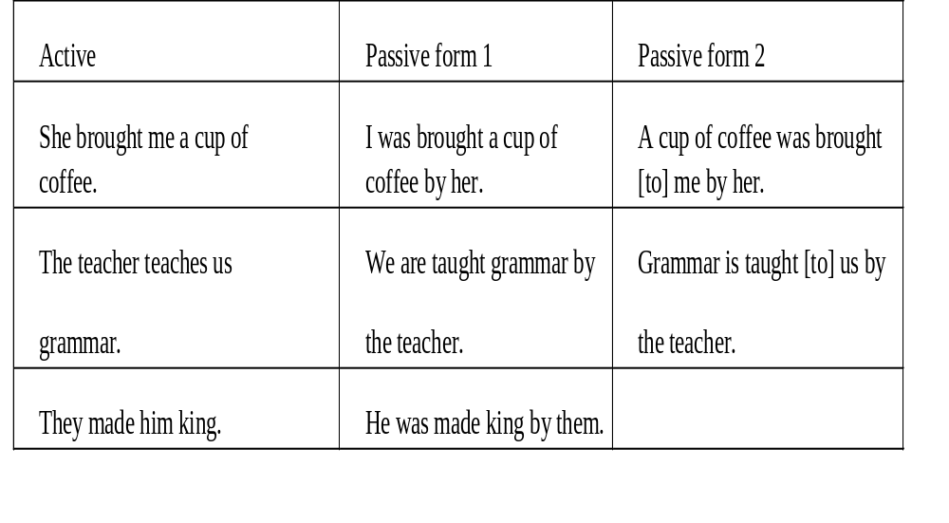
PASSIVE WITH TWO OBJECTS
If a sentence contains two objects namely Indirect Object and Direct Object in the Active Voice, two forms of Passive Voice can be formed

Slide 22
RULES FOR CONVERTING ACTIVE INTO PASSIVE AND VICE VERSA:
Only sentences containing transitive verbs can be changed from the active voice to the passive voice. A subject—that is, a doer of the action—is required to change a sentence from the passive to the active voice. Examples: My mother cut the fruit. The fruit was cut by my mother. Here, the objet ‘fruit’ is acted upon the doe mother.
Active: Mary sings a song.
Passive: A song is sung by Mary

Slide 23
ACTIVE TO PASSIVE (STEPS)
Identify the subject, the verb and the object: SVO
Change the object into subject
Put the suitable helping verb or auxiliary verb. In case helping verb is given, use the same. But note that the helping verb given agrees with the object
Change the verb into past participle of the verb
Add the preposition "by"
Change the subject into object

Slide 24
PASSIVE TO ACTIVE (STEPS)
The object of the passive becomes the subject of the active
The subject of the passive becomes the object of the active
The auxiliary verb and “by” are omitted
The verb in the past participle form is changed to the tense/form of the auxiliary verb. Here, “made” changes to “make” which takes the simple present tense form of the auxiliary “is”
Compare and Study the Changes in the Verb form in both Active and Passive Voices in the Example Sentences in Active and Passive Voice for all the Verb Tenses, Infinitives and Participles

Slide 25
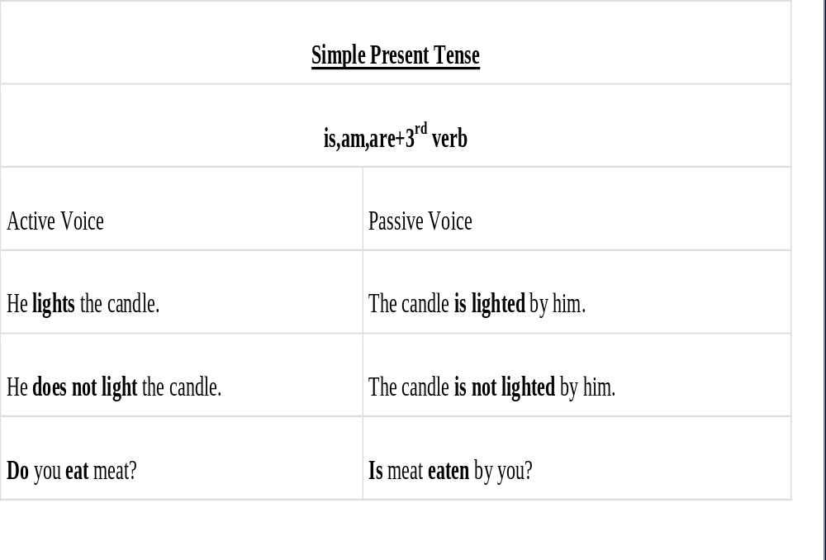

Slide 26
POLL QUESTION
Everyone understands English.
English ________________ by everyone.
A. is understood
b. has been understood
c. was understood

Slide 27
Everyone understands English.
English ________________ by everyone.
A. is understood
b. has been understood
c. was understood

Slide 28
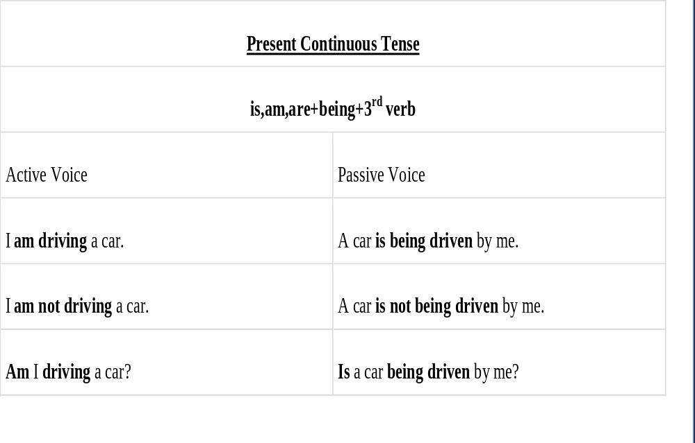

Slide 29
POLL QUESTION
He is not cleaning the blackboard.
[A] The blackboard is not be cleaned by him.
[B] The blackboard is not cleaned by him.
[C] The blackboard is not being cleaned by him.
[D] The blackboard is being not cleaned by him.

Slide 30
He is not cleaning the blackboard.
[A] The blackboard is not be cleaned by him.
[B] The blackboard is not cleaned by him.
[C] The blackboard is not being cleaned by him.
[D] The blackboard is being not cleaned by him.

Slide 31
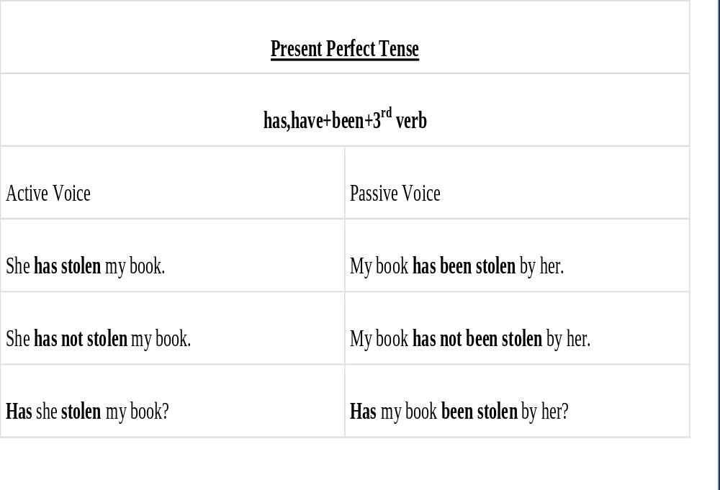

Slide 32
POLL QUESTION
The teacher had punished him.
[A] He had been punished by the teacher.
[B] He is been punished by the teacher.
[C] He was been punished by the teacher.
[D] He had being punished by the teacher.

Slide 33
The teacher had punished him.
[A] He had been punished by the teacher.
[B] He is been punished by the teacher.
[C] He was been punished by the teacher.
[D] He had being punished by the teacher.

Slide 34
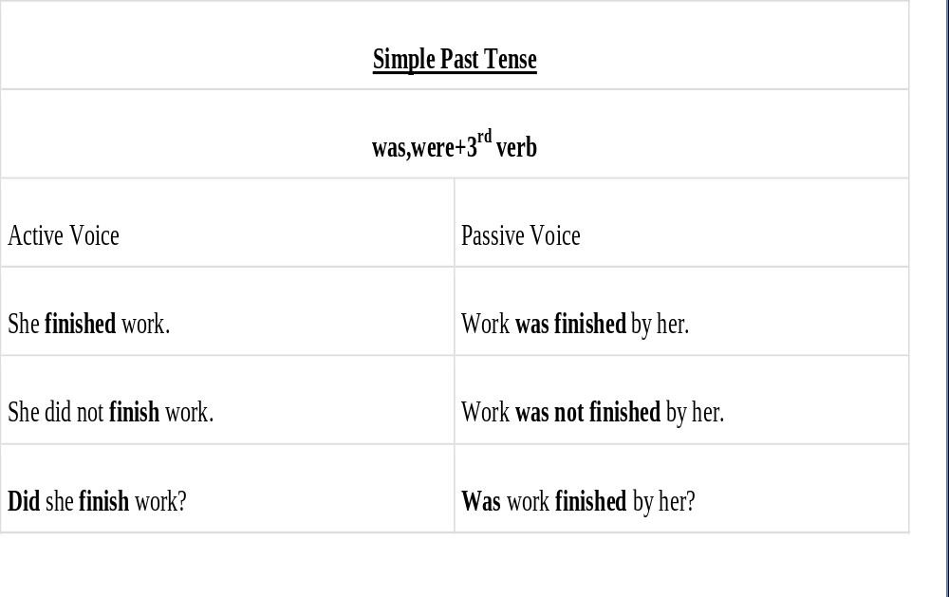

Slide 35
POLL QUESTION
The boy laughed at the beggar.
A. The beggar was laughed by the boy.
B. The beggar was being laughed by the boy.
C. The beggar was being laughed at by the boy.
D. The beggar was laughed at by the boy.

Slide 36
The boy laughed at the beggar.
A. The beggar was laughed by the boy.
B. The beggar was being laughed by the boy.
C. The beggar was being laughed at by the boy.
D. The beggar was laughed at by the boy.

Slide 37
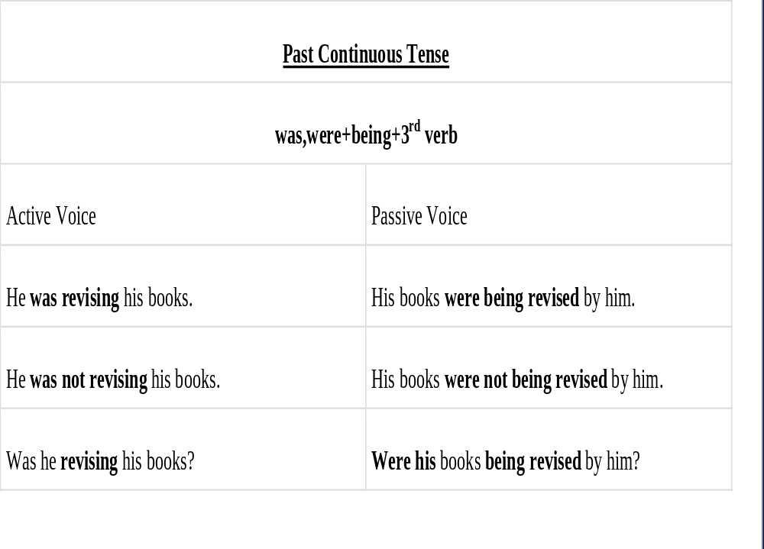

Slide 38
POLL QUESTION
The boys were playing Cricket.
A. Cricket had been played by the boys.
B. Cricket has been played by the boys.
C. Cricket was played by the boys.
D. Cricket was being played by the boys.

Slide 39
The boys were playing Cricket.
A. Cricket had been played by the boys.
B. Cricket has been played by the boys.
C. Cricket was played by the boys.
D. Cricket was being played by the boys.

Slide 40
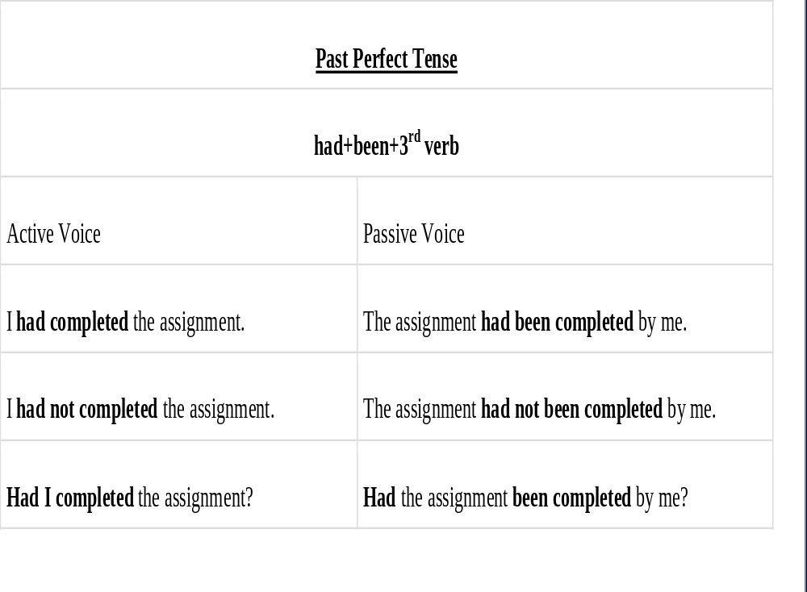

Slide 41
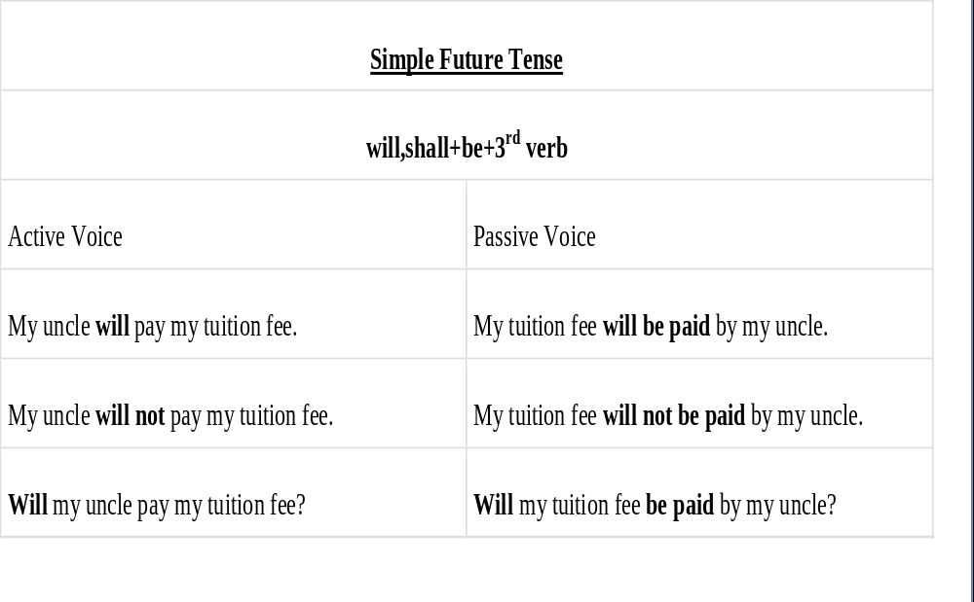

Slide 42
POLL QUESTION
Rahul will pass the message.
The message will passed by Rahul.
The message would be passed by Rahul.
The message will pass by Rahul.
The message will be passed by Rahul

Slide 43
Rahul will pass the message.
The message will passed by Rahul.
The message would be passed by Rahul.
The message will pass by Rahul.
The message will be passed by Rahul

Slide 44
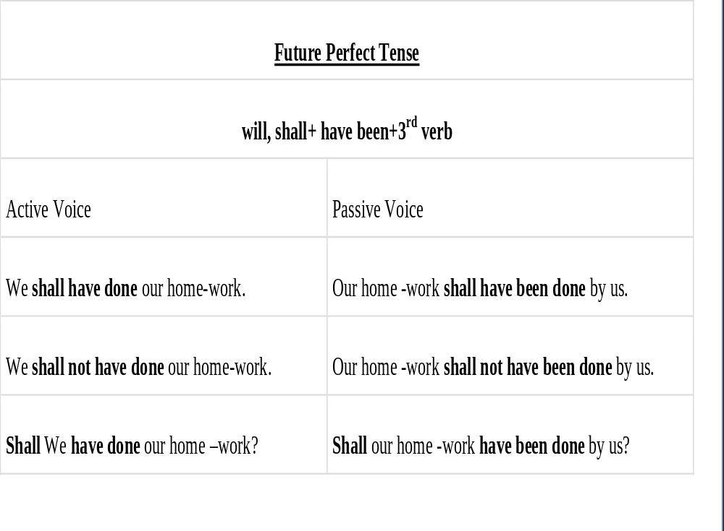

Slide 45
QUESTION:
Which of the following tenses do not usually have passive voice.
A. Future indefinite
B. Future perfect
C. Future Continuous
D. Future Perfect continuous

Slide 46
QUESTION:
The breakfast will have been finished by eight.
A. they will finish the breakfast by eight
B. they will finish the breakfast at eight
C. they will have finished the breakfast by eight
D. they will be finishing the breakfast by eight

Slide 47
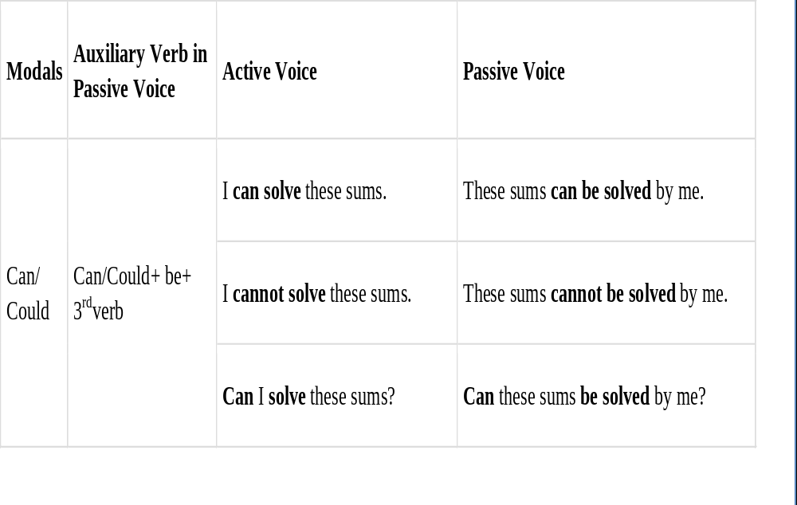
ACTIVE AND PASSIVE VOICE WITH MODALS

Slide 48
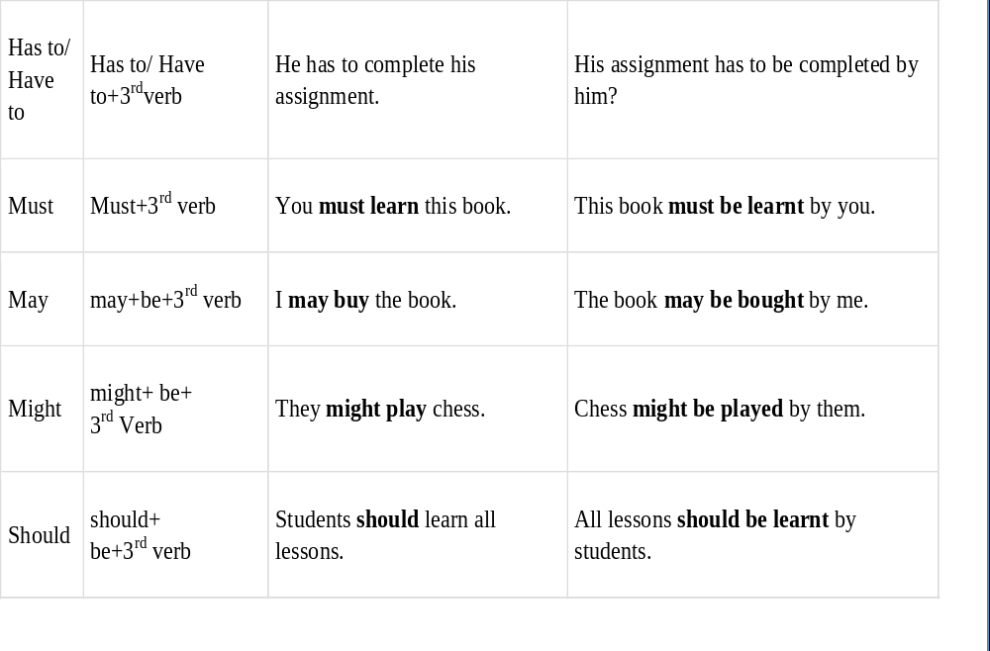

Slide 49
ACTIVE AND PASSIVE VOICE WITH IMPERATIVE SENTENCES
These are the sentences in which we express our feeling and emotions like command, order, advice, and request.
Rules
1. Lets + new object + be/Not be +past participle or 3rd form.
2. For sentences containing, Request, advice and order, we will use you are Requested to, advised to and ordered to .
Note: Always remove please and kind if they are given in the sentence.

Slide 50
QUESTION:
Do all the necessary tests soon.
A. all the necessary tests may be done soon
B. let all the necessary tests be done soon.
C. let all the necessary tests have been done soon.

Slide 51
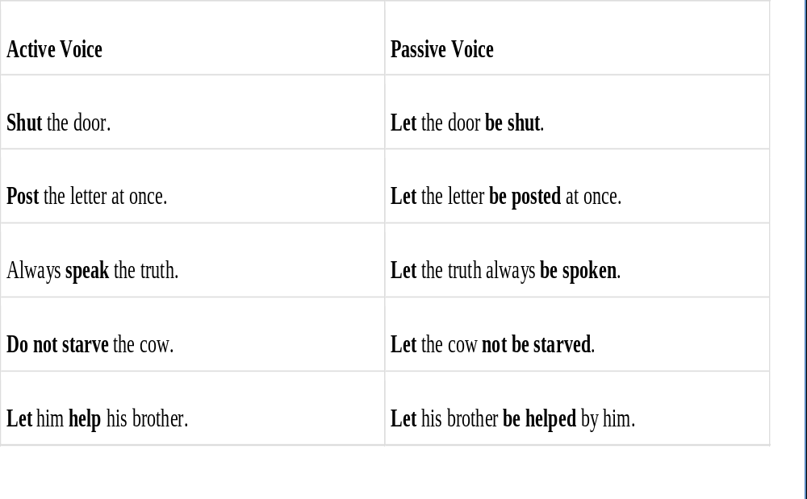

Slide 52
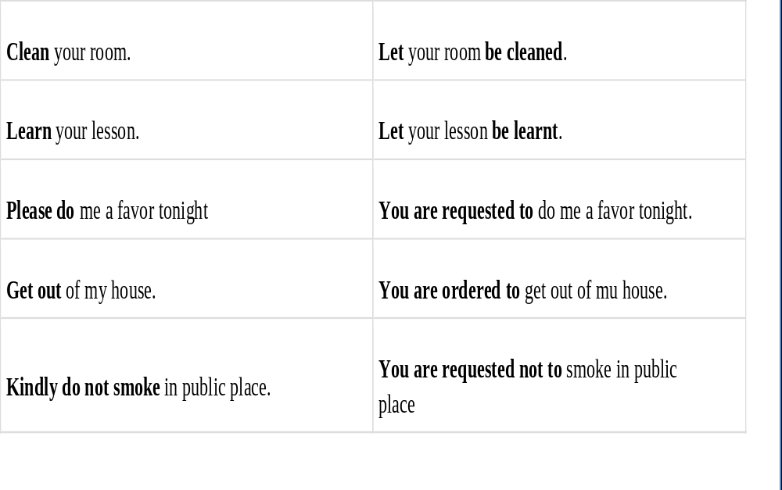

Slide 53
TO MAKE PASSIVE VOICE, FIRST OF ALL YOU HAVE TO USE FOLLOWING RULES.
1.Change the object into subject. If in object, we have a pronoun of object case convert that by following rules.
Me | I
You | You
Her | She
Them | They
Us | We
Him | He
It | It
Whom | Who

Slide 54

2. CHANGE THE SUBJECT INTO OBJECT. AND USE BY BEFORE THE OBJECT. IF IN SUBJECT, WE HAVE A PRONOUN OF NOMINATIVE CASE CONVERT THAT BY THE FOLLOWING RULES.

Slide 55
